Slide 1


Chiraag P V
06-10-2022

Slide 2

Outline
Executive Summary
Introduction
Methodology
Results
Conclusion
Appendix

Slide 3
Executive Summary
METHEDOLOGIES
Collecting the data using API and Web scraping.
Exploratory Data Analysis (EDA) with Visualization.
Analysing the locations of the launch sites.
Using Machine Learning to predict success rate of rocket launch.
RESULTS
A good amount of data was collected and cleaned.
Graphs were built for better understanding.
Determined the launch sites and their success rates of a rocket launch.
Classification Algorithms were used to best classify the launch.

Slide 4
Introduction
Our aim is to build a new Space company called SpaceY.
We are using the dataset of SpaceX to get better insights on how the company must function and take decisions in a better way.
This project helps us to find out best locations for launch site.
We can estimate cost for launches, required elements for a space project and more.

Slide 5

Section 1

Slide 6
Methodology
Executive Summary
Data collection methodology:
Data was collected using API and Web Scarping.
Perform data wrangling
Data was cleaned and processed using normalization and one-hot encoding to get better results
Perform exploratory data analysis (EDA) using visualization and SQL
Perform interactive visual analytics using Folium and Plotly Dash
Perform predictive analysis using classification models
Using Logistic Regression, SVM's, KNN and Decision tree Algorithms to best classify models using Grid Search.

Slide 7
Data Collection
Data Sets were collected using API's and Web Scraping.
Data was collected using API's by sending requests to fetch the results of URL and the response was used to fetch the required data.
Data was also collected by Web Scraping using Beautiful Soup Library.

Slide 8
Data Collection – SpaceX API
response = requests.get(spacex_url)
data = pd.json_normalize(response.json())
An URL was added to a variable spacex_url and the response was fetched using request.get().
Later the data was normalized and converted to pandas data frame.
Check out the complete code : CLICK HERE
Request the data using SpaceX API
Read the data to a pandas data frame by normalizing them
Clean the data by adding the missing values in the best possible way

Slide 9
Data Collection - Scraping
Response = requests.get(static_url)
soup = BeautifulSoup(response.text,'html5lib')
html_tables = soup.findAll('table')
Now, we iterate through the headers(<th>), extract the data and store it in the form of a table.
Check out the complete code : CLICK HERE
Extract the data using the URL
Use the response and create a BeautifulSoup object
Use BeautifulSoup to extract the required data and store it using pandas

Slide 10
Data Wrangling
We need to clean the dataset in order to do better data analysis and to obtain better results.
We use the actual data and determine the best possible ways to look into a data.
df.isnull().sum()/df.count()*100 : Used to check null values in the data.
df.dtypes : Used to check the datatypes.
Check out the complete code : CLICK HERE

Slide 11
EDA with Data Visualization
Data Visualization is most necessary as a part of Exploratory Data Analysis. This helps in analyzing the data in an easier way using graphs and charts.
Scatter plots were created between many attributes to obtain their relationship.
Bar Charts, Line Charts and Cat plots were also created to analyze the data.
Check out the complete code : CLICK HERE

Slide 12
EDA with SQL
We will be adding the data to a database where we can query the reuired results using SQL.
We have displayed the names of unique launch sites, total payload mass carried by boosters launched by NASA (CRS) and many more,
We can SQL and extract the data for analysis using Pattern Matching, Buil-in Mathematical Functions and many more
Check out the complete code : CLICK HERE

Slide 13
Build an Interactive Map with Folium
We can build an interactive map with Folium which can provide us better view of the launch sites and distance from source to destination and many more.
We have used folium.circle and folium.map.marker and many other object of Folium Library.
Folium.circle : creates a circle of given radius on the map after providing latitudes and longitudes of the location.
Folium.map.marker : creates a marker on the specified location.
Check out the complete code : CLICK HERE

Slide 14
Build a Dashboard with Plotly Dash
We have created a real-time visual dashboard using Plotly which provides better view of Graphs and Charts.
The plots were added to the dashboard because it provides real-time experience to the users with a great view of data.
Added a dropdown to the dashboard to select launch sites and find the EDA of that particular launch site.
Check out the complete code : CLICK HERE

Slide 15
Predictive Analysis (Classification)
A Classification model is built in order to predict the success of rocket launch
There are 4 classification models used :
Logistic Regression
Support Vector Machines
Decision Tree
K – Nearest Neighbours
The accuracy of the model is determined using best_score and confusion matrix.
Check out the complete code : CLICK HERE

Slide 16
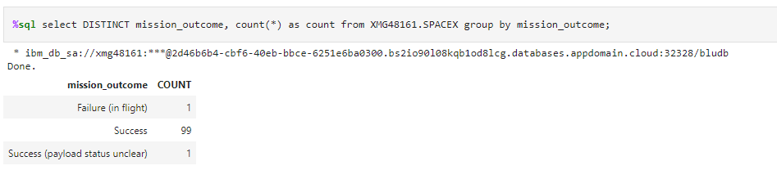
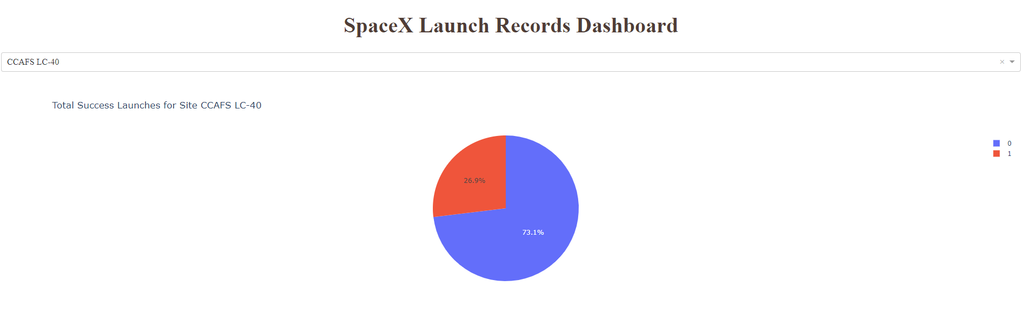
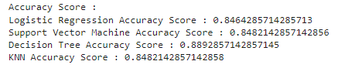
Results
Exploratory data analysis results :
Interactive analytics samples :
Predictive analysis results :

Slide 17

Section 2

Slide 18
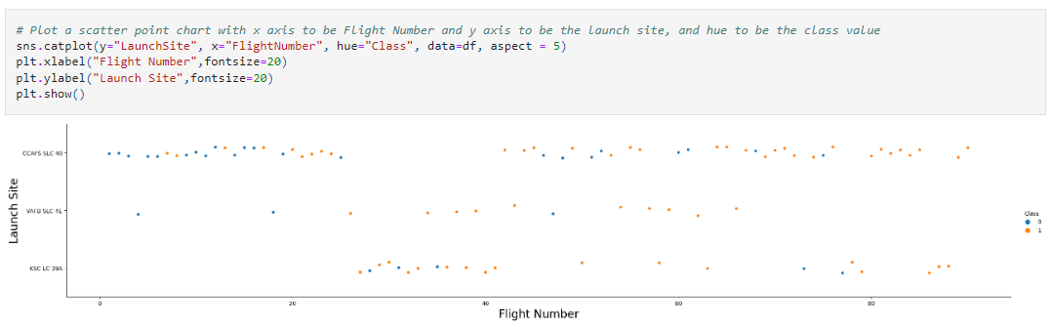
Flight Number vs. Launch Site
Scatter plot for Flight Number vs. Launch Site :
A scatter plot is built with X-axis as Flight Number and Y-axis as Launch Site. This does not provide us much insights, lets carry on further.

Slide 19
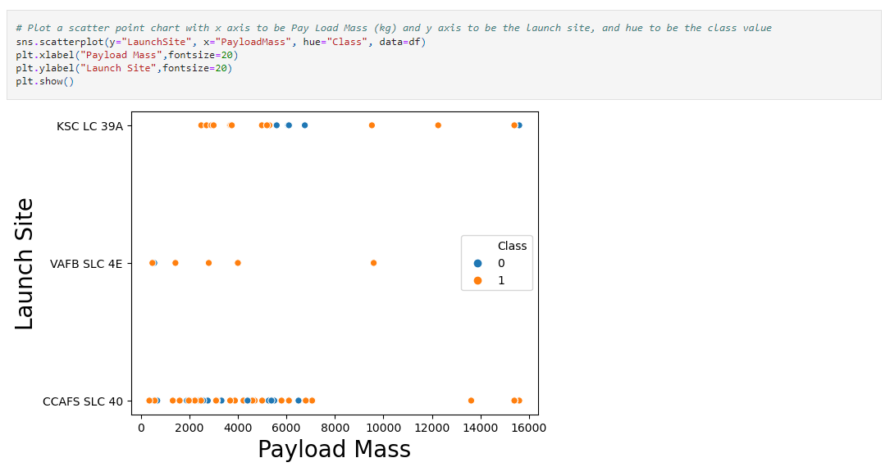
Payload vs. Launch Site
Scatter Plot for Payload vs. Launch Site
We can find that heavier Payload Mass rockets are launched in KSC LC 39A and CCAFS SLC 40 Launch Sites.

Slide 20
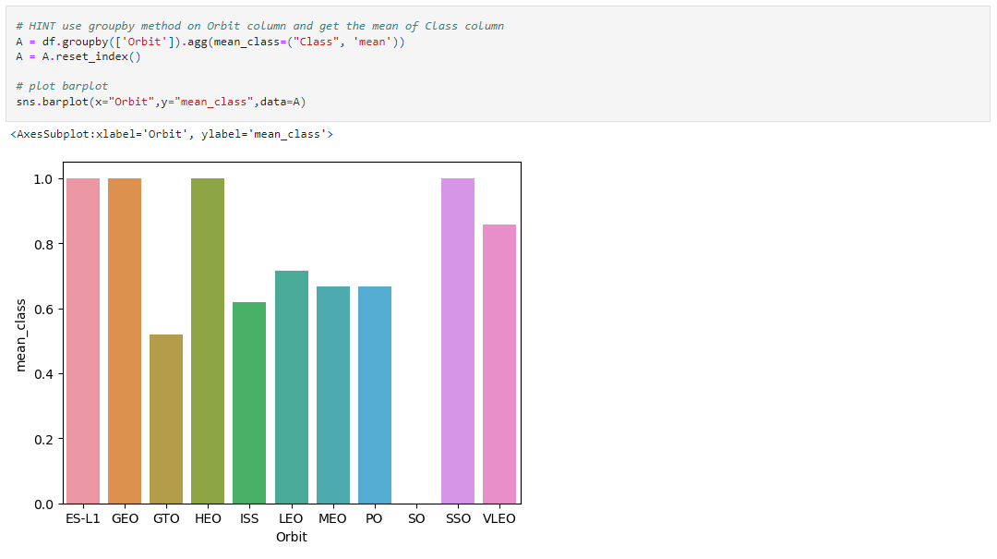
Success Rate vs. Orbit Type
Success rate of each orbit type using Bar Plot :
We can see that rockets launched to ES-L1, GEO, HEO and SSO orbits have higher success rate.

Slide 21
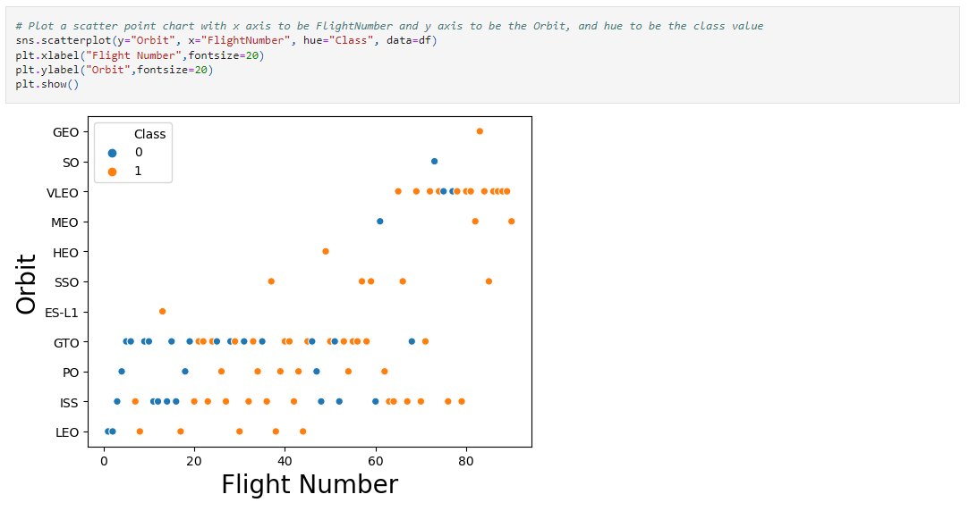
Flight Number vs. Orbit Type
Scatter Plot of Flight number vs. Orbit type
We can obtain insights by seeing the number of flights launched to specific orbits but cannot fetch better insights when Flight Number is considered.

Slide 22
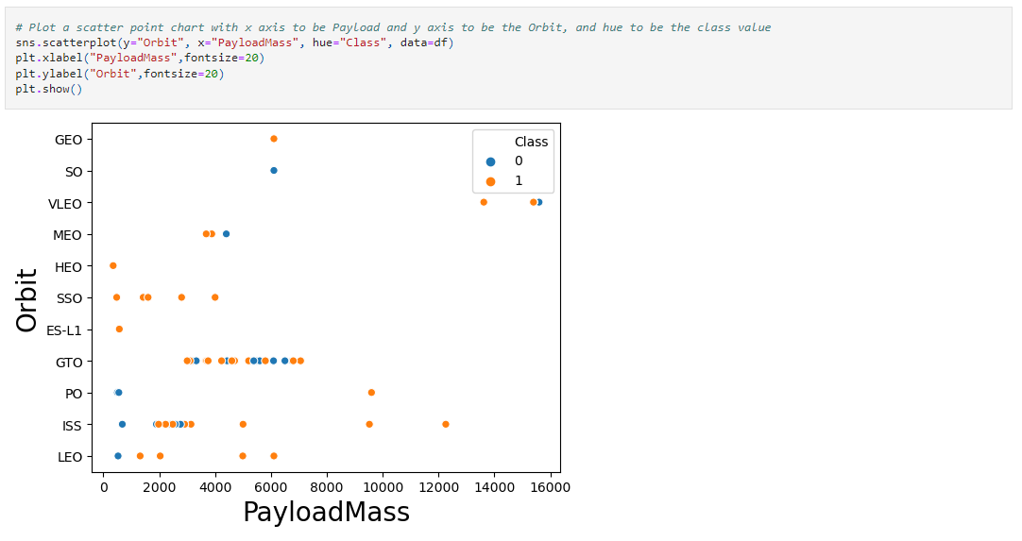
Payload vs. Orbit Type
Scatter plot of payload vs. orbit type
We can see that with heavy payloads the successful landing rate is more for Polar, VLEO and ISS.

Slide 23
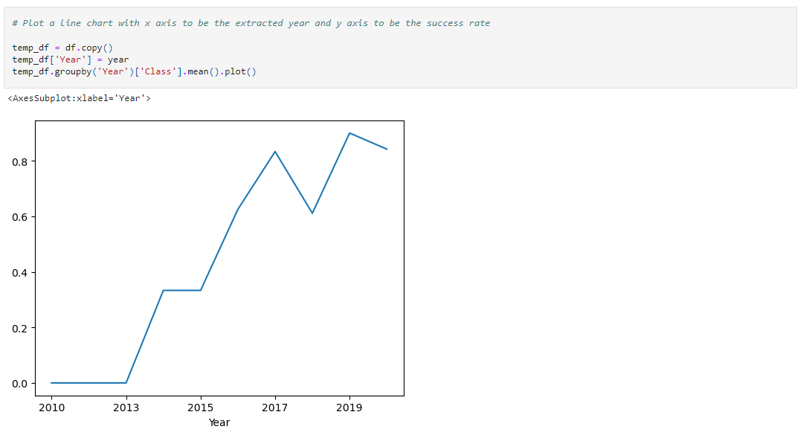
Launch Success Yearly Trend
Line chart of yearly average success rate
Success rate after 2013 keeps increasing.

Slide 24
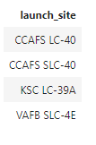
All Launch Site Names
Unique launch sites :
Query : %sql select DISTINCT launch_site from XMG48161.SPACEX;
This query provides us distinct or unique launch sites present.

Slide 25
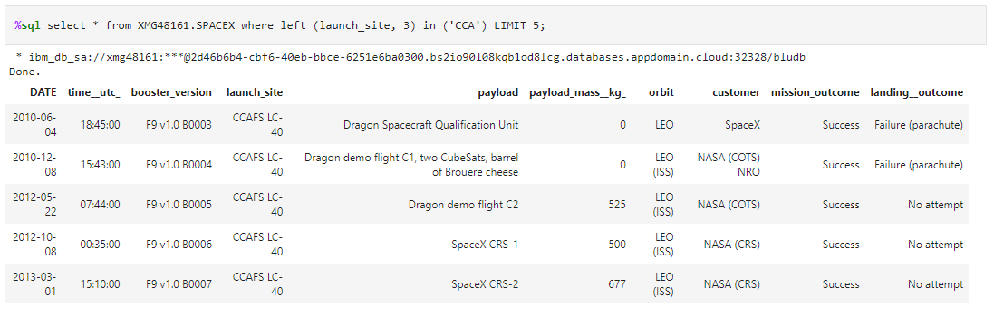
Launch Site Names Begin with 'CCA'
5 records where launch sites begin with `CCA` :
Query : %sql select * from XMG48161.SPACEX where left (launch_site, 3) in ('CCA') LIMIT 5;
This query provides 5 records of launch sites which begins with 'CCA'.

Slide 26
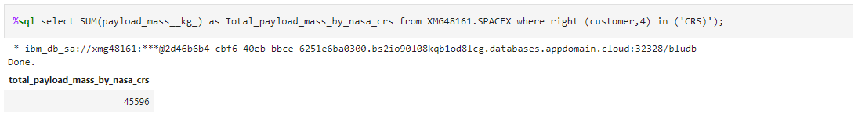
Total Payload Mass
Total payload carried by boosters from NASA
Query : %sql select SUM(payload_mass__kg_) as Total_payload_mass_by_nasa_crs from XMG48161.SPACEX where right (customer,4) in ('CRS)');
This query provides us the total payload carried by booster that are launched by NASA.

Slide 27
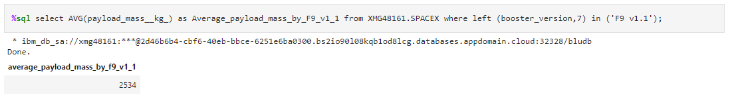
Average Payload Mass by F9 v1.1
Average payload mass carried by booster version F9 v1.1
Query : %sql select AVG(payload_mass__kg_) as Average_payload_mass_by_F9_v1_1 from XMG48161.SPACEX where left (booster_version,7) in ('F9 v1.1');
This query provides us the average of payload mass that was carried by F9 v1.1 booster version.

Slide 28
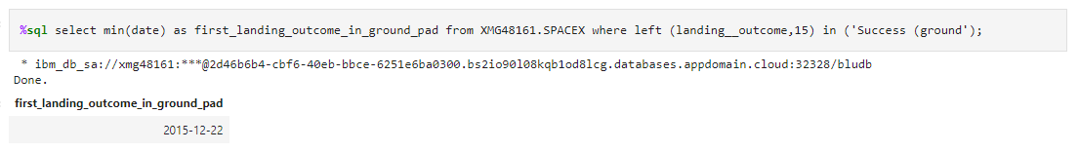
First Successful Ground Landing Date
Dates of the first successful landing outcome on ground pad
Query : %sql select min(date) as first_landing_outcome_in_ground_pad from XMG48161.SPACEX where left (landing__outcome,15) in ('Success (ground');
Using this query we can extract the date of first landing outcome on ground pad.

Slide 29
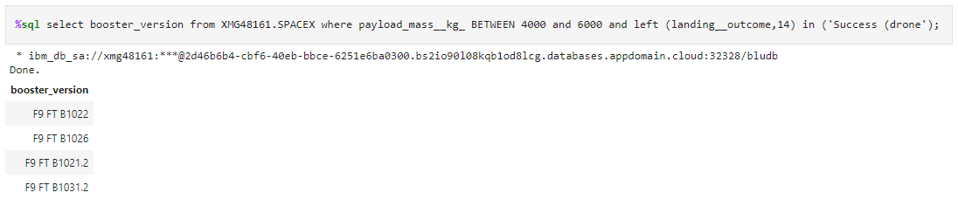
Successful Drone Ship Landing with Payload between 4000 and 6000
Names of boosters which have successfully landed on drone ship and had payload mass greater than 4000 but less than 6000
Query : %sql select booster_version from XMG48161.SPACEX where payload_mass__kg_ BETWEEN 4000 and 6000 and left (landing__outcome,14) in ('Success (drone');
This query provides the result of boosters which have successfully landed on drone ship and had payload mass greater than 4000 but less than 6000

Slide 30
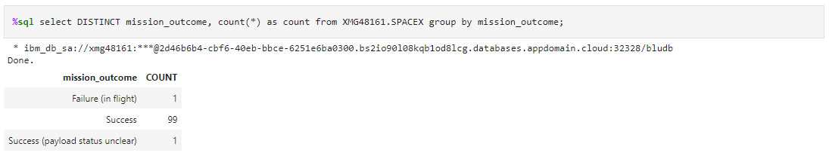
Total Number of Successful and Failure Mission Outcomes
Total number of successful and failure mission outcomes
Query : %sql select DISTINCT mission_outcome, count(*) as count from XMG48161.SPACEX group by mission_outcome;
This query groups the output based on mission_outcomes and provides the count.

Slide 31
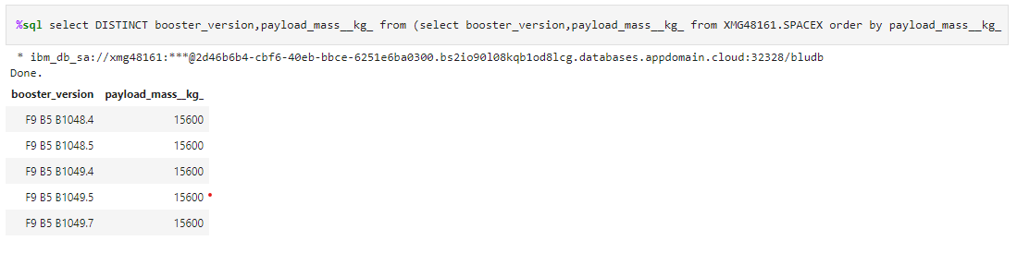
Boosters Carried Maximum Payload
Names of the booster which have carried the maximum payload mass
Query : %sql select DISTINCT booster_version,payload_mass__kg_ from (select booster_version,payload_mass__kg_ from XMG48161.SPACEX order by payload_mass__kg_ DESC ) LIMIT 5;
This query provides the names of the boosters which have carried the maximum payload mass.

Slide 32
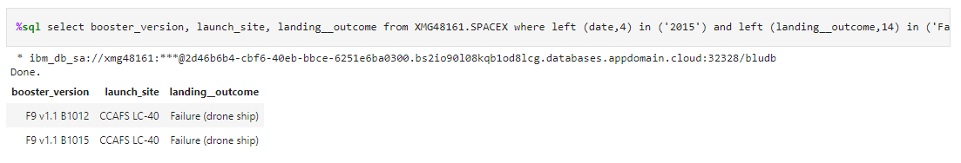
2015 Launch Records
Failed landing_outcomes in drone ship, their booster versions, and launch site names for in year 2015
Query : %sql select booster_version, launch_site, landing__outcome from XMG48161.SPACEX where left (date,4) in ('2015') and left (landing__outcome,14) in ('Failure (drone');
Failed landing_outcomes in drone ship, their booster versions, and launch site names for in year 2015

Slide 33
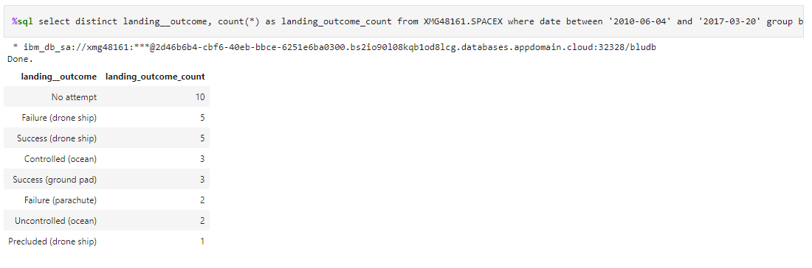
Rank Landing Outcomes Between 2010-06-04 and 2017-03-20
Rank the count of landing outcomes (such as Failure (drone ship) or Success (ground pad)) between the date 2010-06-04 and 2017-03-20, in descending order
Query : %sql select distinct landing__outcome, count(*) as landing_outcome_count from XMG48161.SPACEX where date between '2010-06-04' and '2017-03-20' group by landing__outcome order by landing_outcome_count desc ;

Slide 34

Section 3

Slide 35
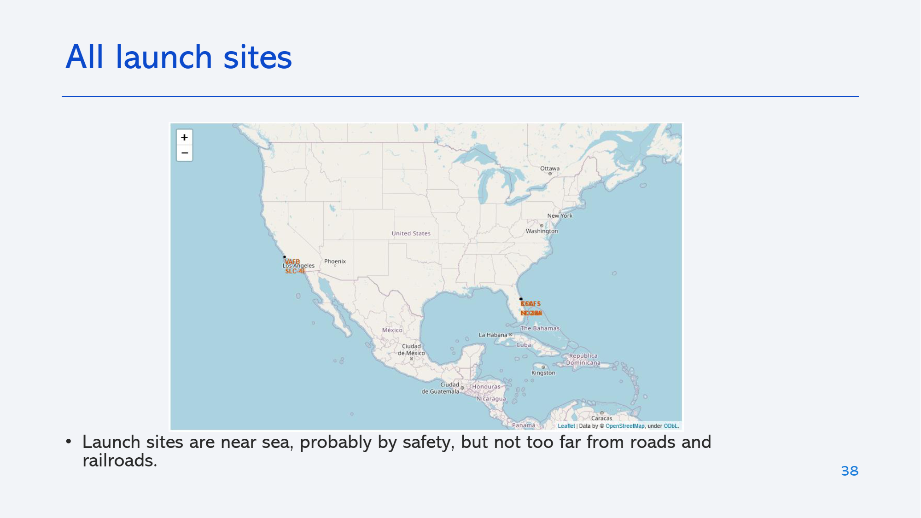
All Launch Sites
All the launch sites are near to the sea.
The launch should be taken with utmost safety as there is some areas of land nearby.

Slide 36
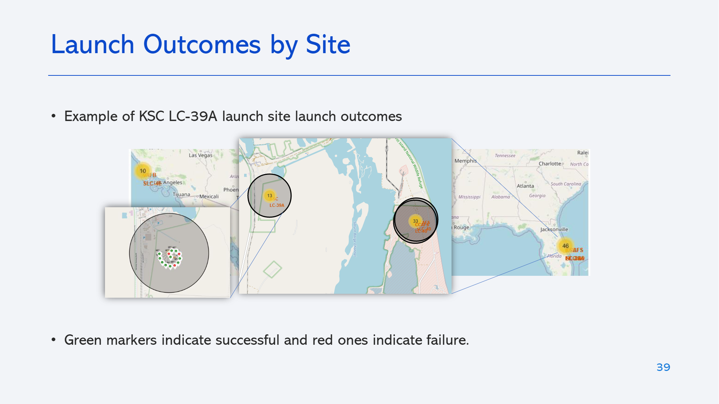
Launch Outcomes based on Sites
KSC LC – 39A Launch Site
The green markers in the map gives out successful launch outcomes and red marker gives out failed launch outcomes

Slide 37
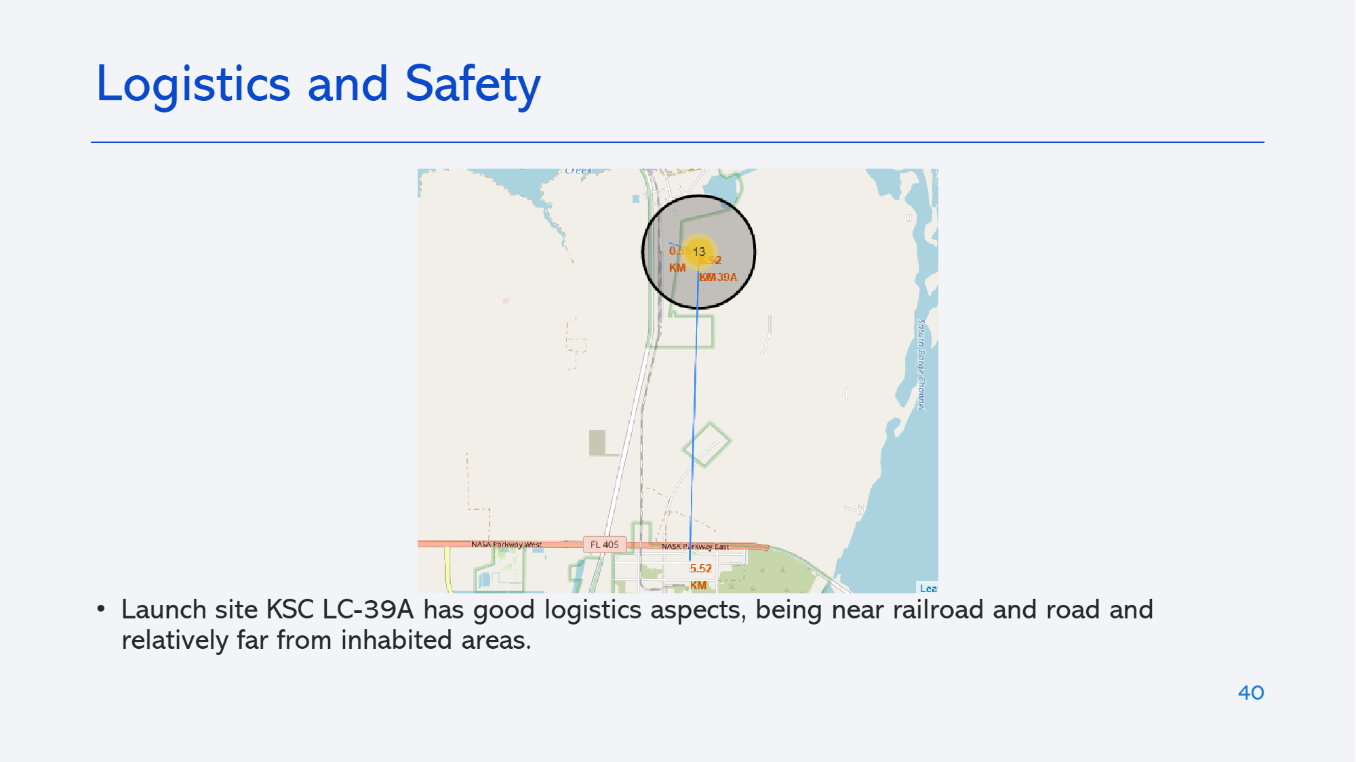
Distance between Launch Sites to its proximities
A line is drawn between the launch site and its closest Highway.

Slide 38

Section 4

Slide 39
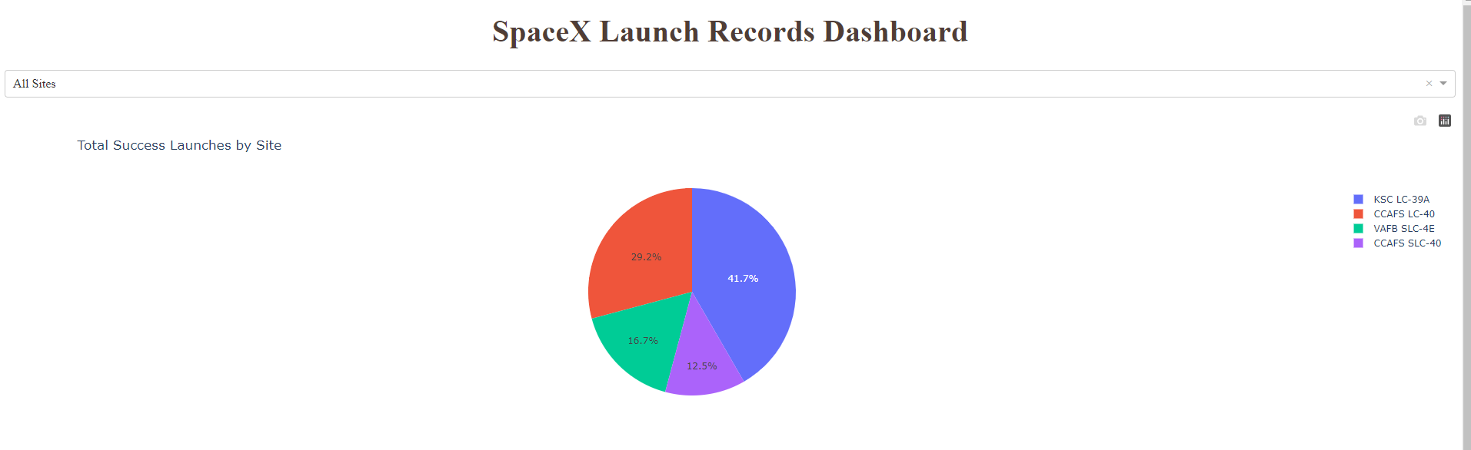
Pie Chart with success rates based on launch sites
This dashboard contains a pie chart with the success rate of rocket launched based on sites.

Slide 40
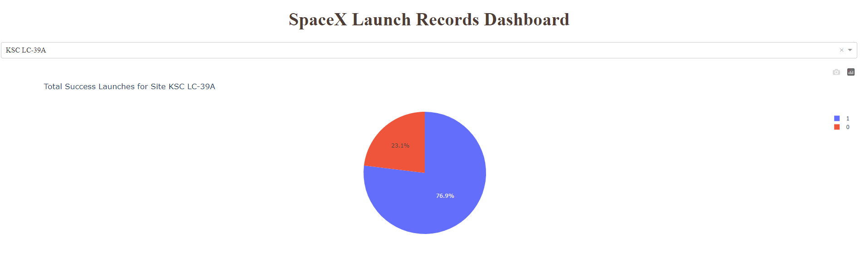
Pie Chart with Highest Launch Site Success ration
This dashboard contains the pie chart which has the highest successful launches based on Launch Site

Slide 41
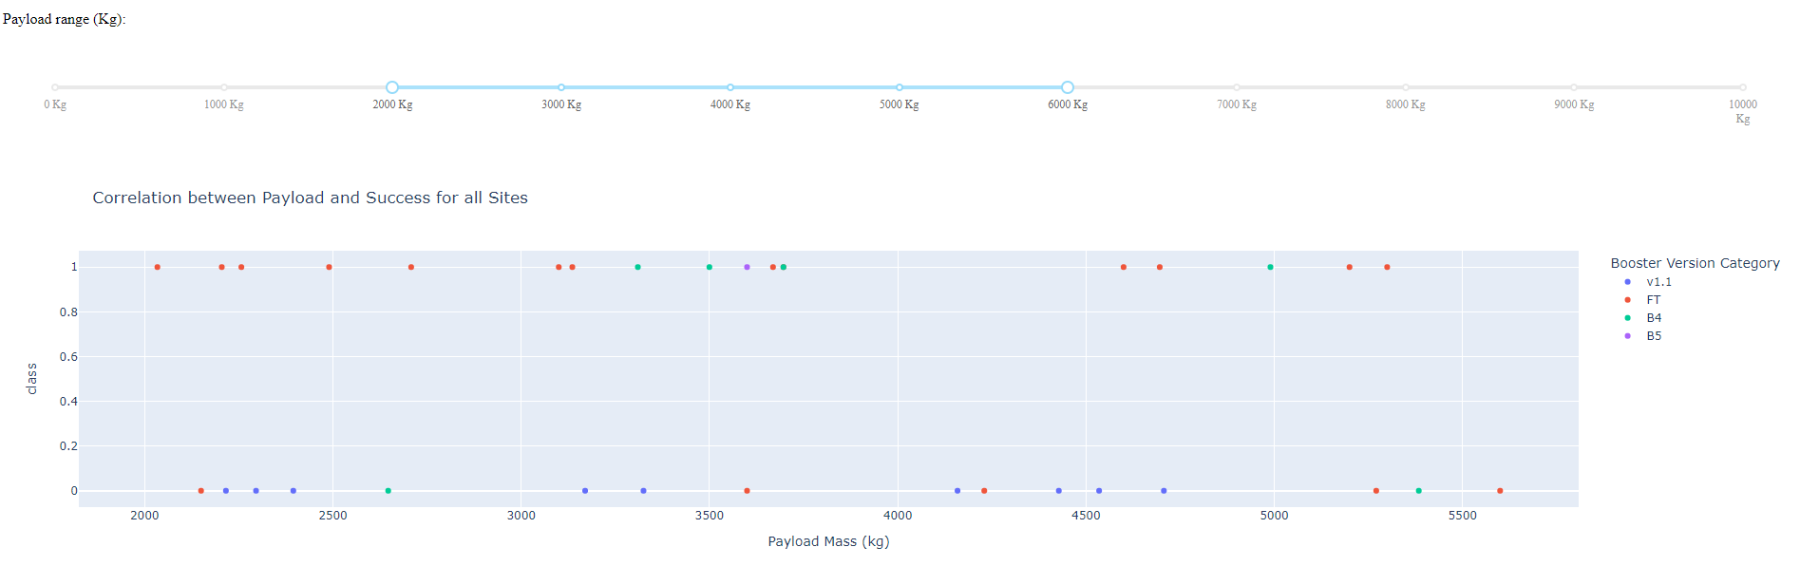
Scatter Plot between Class and Payload Mass
This Scatter Plot shows the success rate based on Payload Mass of rockets between 2000 and 6000 KG

Slide 42

Section 5

Slide 43
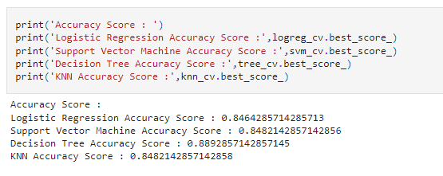
Classification Accuracy
In this, we can see that Decision Tree Algorithm is providing the best accuracy.

Slide 44
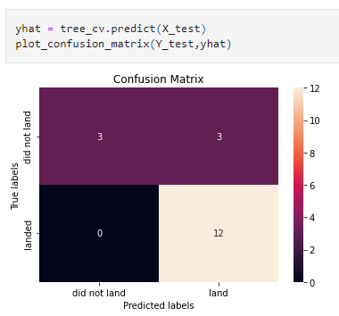
Confusion Matrix
True Positives -12 (landed and land)
True Negatives - 0 (landed and did not land)
False Positives – 3 (did not land and did not land)
False Negatives – 3 (did not land and land)

Slide 45
Conclusions
This project shows various ways to extract the data using API's and Beautiful Soup. It also shows the usage of pandas and numpy for Data Collection and Analysis.
Exploratory Data Analysis carried out using Plotly, Seaborn as a part of Data Visualization and data is analyzed using SQL. Both of which has provided good EDA Analysis.
Getting a better image of the launch sites using the Folium maps. A lot of insights based on locations of Launch Sites on the maps can be seen.
Used 4 Classification Algorithms using Grid Search which predicts if a rocket launched will be carried out successful or not.
Decision Tree Algorithm came out with highest accuracy.

Slide 46
Appendix
Using a lot of in-built libraries like pandas, numpy, seaborn, plotly and many more.
Used magic sql to execute sql queries in python notebook.

Slide 47


